Slide 1
Case Study- Inventory Analysis in Tableau
File created on: 11/13/2025 11:16:17 AM

Slide 2
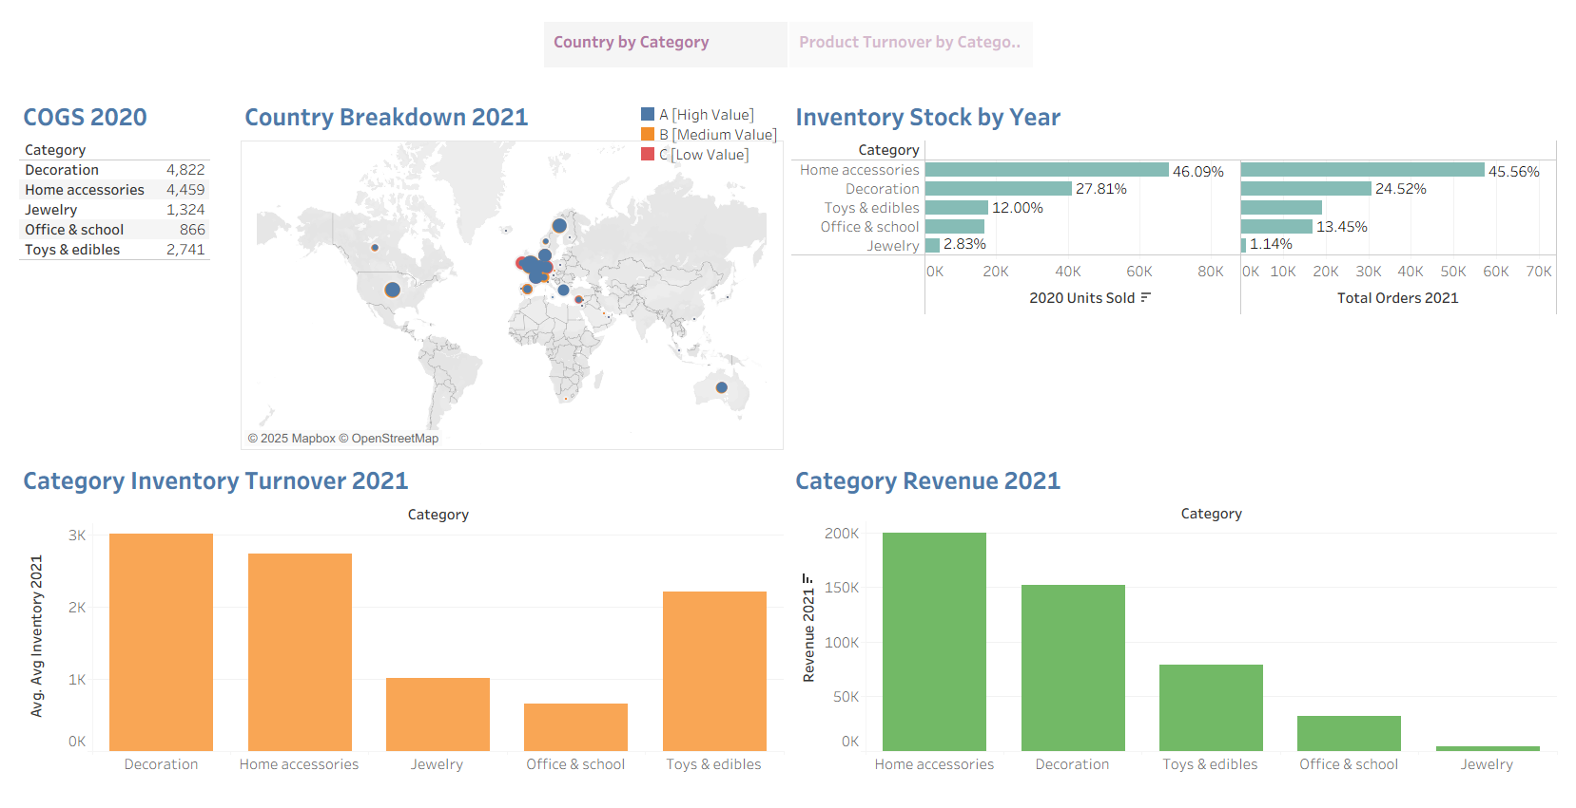

Slide 3
